Slide 1
Reproducibility and dimension reduction in the study of the human microbiome
Anthony Fodor
Bioinformatics and Genomics
UNC Charlotte

Slide 2
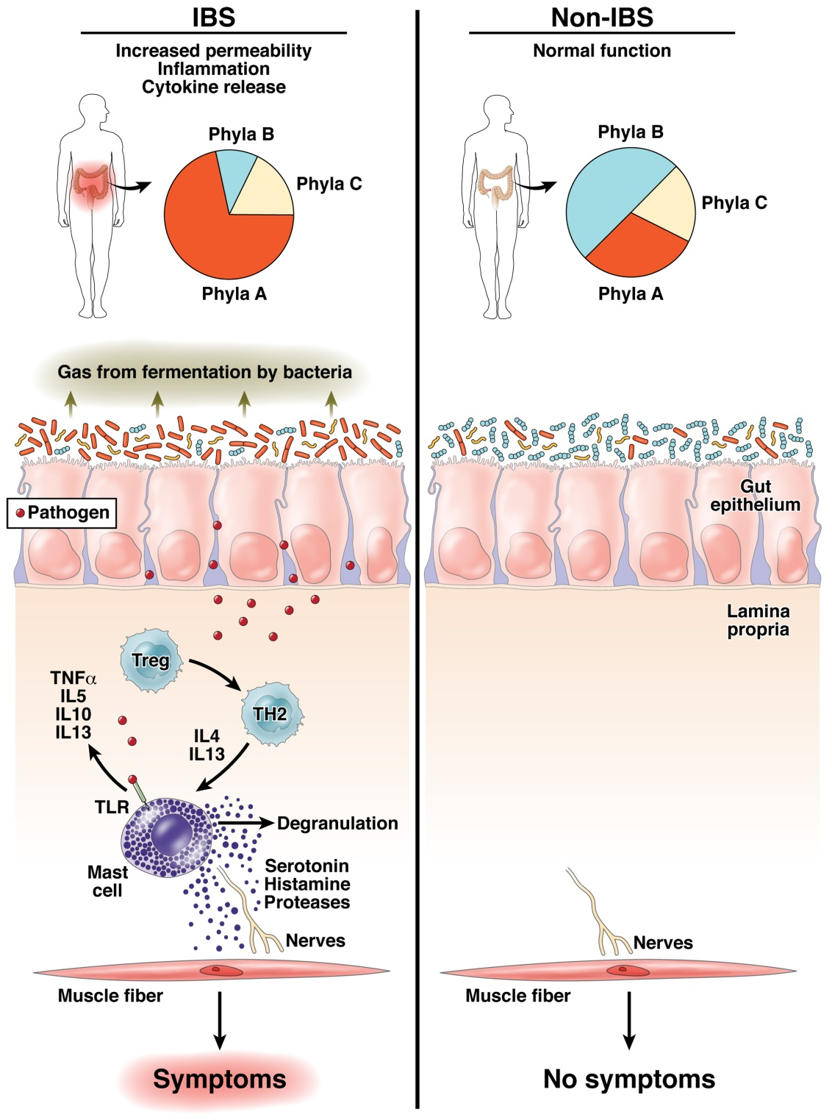
The “dysbiosis” hypothesis linking risk for inflammation related diseases to the microbiome
Fodor & Talley. Gastroenterology. 2011

Slide 3
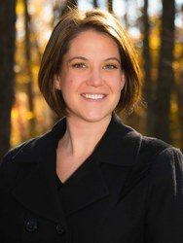
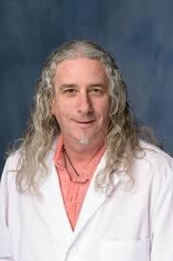
Some microbes, but not others, can cause inflammation to progress to cancer…
IL10 is an anti-inflammatory
cytokine
Gnotobiotic IL10-/- mice
Mono-associated with
E. Coli or E. faecalis
Exposed to carcinogen AOM
Janelle Arthur, UNC
Christian Jobin, UFL
Intestinal inflammation targets cancer-inducing activity of the microbiota Arthur et al, Science, 2012

Slide 4
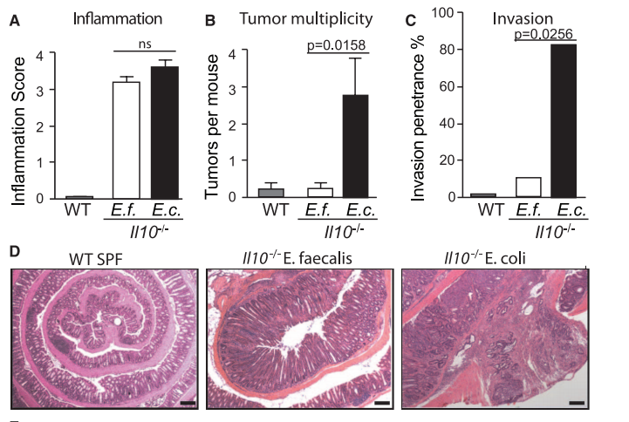
Some microbes, but not others, can cause inflammation to progress to cancer…
IL10 is an anti-inflammatory
cytokine
Gnotobiotic IL10-/- mice
Mono-associated with
E. Coli or E. faecalis
Exposed to carcinogen AOM
Janelle Arthur, UNC
Christian Jobin, UFL
Intestinal inflammation targets cancer-inducing activity of the microbiota Arthur et al, Science, 2012

Slide 5
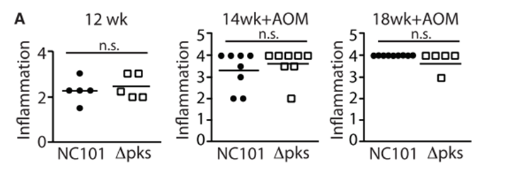
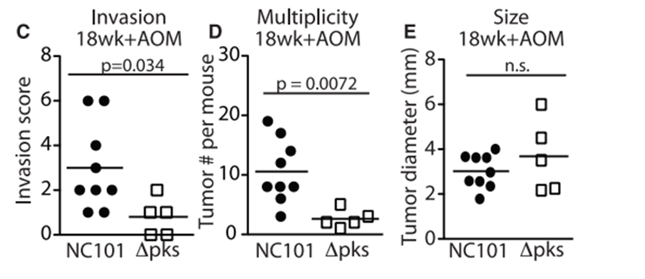
Remarkably, the PKS island appears essential in promoting progress to CRC
Intestinal inflammation targets cancer-inducing activity of the microbiota Arthur et al, Science, 2012

Slide 6
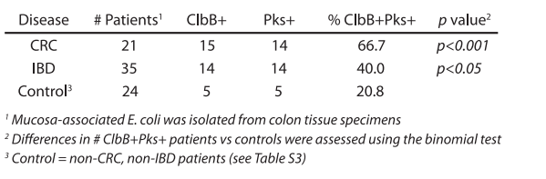
The presence of PKS is associated with cancers in multiple human cohorts
Intestinal inflammation targets cancer-inducing activity of the microbiota Arthur et al, Science, 2012

Slide 7
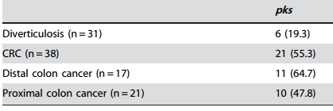
The presence of PKS is associated with cancers in multiple human cohorts
Buc et al - High Prevalence of Mucosa-Associated E. coli Producing
Cyclomodulin and Genotoxin in Colon Cancer (2013)

Slide 8
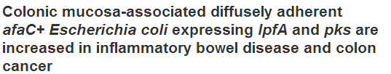
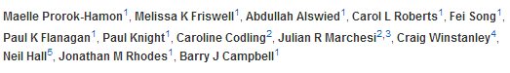
The presence of PKS is associated with cancers in multiple human cohorts
Buc et al - High Prevalence of Mucosa-Associated E. coli Producing
Cyclomodulin and Genotoxin in Colon Cancer (2013)

Slide 9
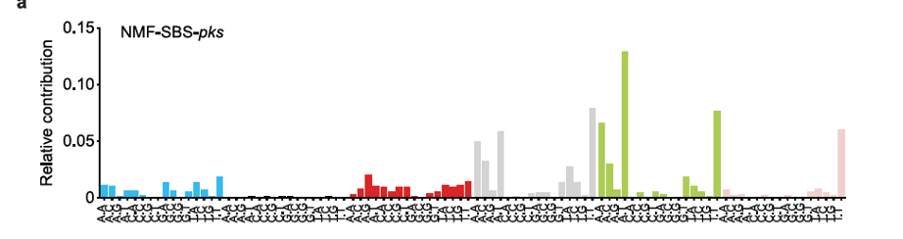

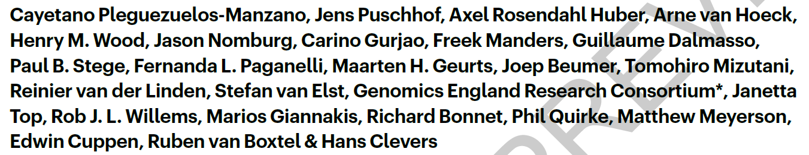
We have increasing detail on the chain of causality
Interferes with
selection against
Inflammation
E. coli/pks
The damage pks-E. Coli
does to DNA can be
directly measured and
quantified
“Invade” the gut
during stress/birth
Stresses host cells
Proteobacteria in
the external enviroment
Cancer
Approximately 5% of all CRCs have a mutational spectrum signature
consistent with E. Coli/pks damage

Slide 10
It is not always straight-forward to elucidate mechanism

Slide 11
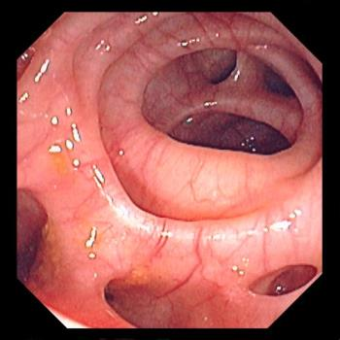

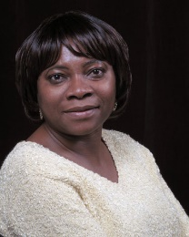
Roshonda Barner Jones
University of Southern California
Biopsies from 226 case and 309 control obtained via
colonoscopy
Temitope Keku
UNC Chapel Hill
Image: https://www.merckmanuals.com/-/media/manual/professional/images/diverticulosis_high.jpg?la=en&thn=0&mw=350
An Aberrant Microbiota is not Strongly Associated with Incidental Colonic Diverticulosis Roshonda B. Jones, Anthony A. Fodor, Anne F. Peery, Matthew C. B. Tsilimigras, Kathryn Winglee, Amber McCoy,Michael Sioda ,Robert S. Sandler, Temitope O. Keku. Scientific Reports. 2018.
Notes:
A colonic diverticulum is a saclike pouch of colonic mucosa and submucosa that protrudes through the muscular layer of the colon

Slide 12
Roshonda Barner Jones
University of Southern California
Biopsies from 226 case and 309 control obtained via
colonoscopy
Temitope Keku
UNC Chapel Hill
Microbial DNA extracted – PCR targeting the 16S rRNA gene
Image: https://www.merckmanuals.com/-/media/manual/professional/images/diverticulosis_high.jpg?la=en&thn=0&mw=350
An Aberrant Microbiota is not Strongly Associated with Incidental Colonic Diverticulosis Roshonda B. Jones, Anthony A. Fodor, Anne F. Peery, Matthew C. B. Tsilimigras, Kathryn Winglee, Amber McCoy,Michael Sioda ,Robert S. Sandler, Temitope O. Keku. Scientific Reports. 2018.
Notes:
A colonic diverticulum is a saclike pouch of colonic mucosa and submucosa that protrudes through the muscular layer of the colon

Slide 13
Roshonda Barner Jones
University of Southern California
Biopsies from 226 case and 309 control obtained via
colonoscopy
Temitope Keku
UNC Chapel Hill
Microbial DNA extracted – PCR targeting the 16S rRNA gene
Sequences generated via Illumina sequencing.
Classified into a counts table
Image: https://www.merckmanuals.com/-/media/manual/professional/images/diverticulosis_high.jpg?la=en&thn=0&mw=350
An Aberrant Microbiota is not Strongly Associated with Incidental Colonic Diverticulosis Roshonda B. Jones, Anthony A. Fodor, Anne F. Peery, Matthew C. B. Tsilimigras, Kathryn Winglee, Amber McCoy,Michael Sioda ,Robert S. Sandler, Temitope O. Keku. Scientific Reports. 2018.
Notes:
A colonic diverticulum is a saclike pouch of colonic mucosa and submucosa that protrudes through the muscular layer of the colon

Slide 14
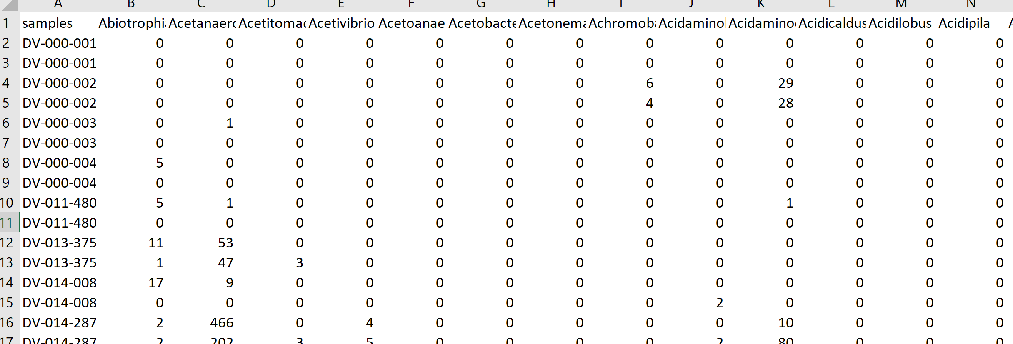
Roshonda Barner Jones
University of Southern California
Biopsies from 226 case and 309 control obtained via
colonoscopy
Temitope Keku
UNC Chapel Hill
Microbial DNA extracted – PCR targeting the 16S rRNA gene
Sequences generated via Illumina sequencing.
Classified into a counts table
Image: https://www.merckmanuals.com/-/media/manual/professional/images/diverticulosis_high.jpg?la=en&thn=0&mw=350
An Aberrant Microbiota is not Strongly Associated with Incidental Colonic Diverticulosis Roshonda B. Jones, Anthony A. Fodor, Anne F. Peery, Matthew C. B. Tsilimigras, Kathryn Winglee, Amber McCoy,Michael Sioda ,Robert S. Sandler, Temitope O. Keku. Scientific Reports. 2018.
Notes:
A colonic diverticulum is a saclike pouch of colonic mucosa and submucosa that protrudes through the muscular layer of the colon

Slide 15
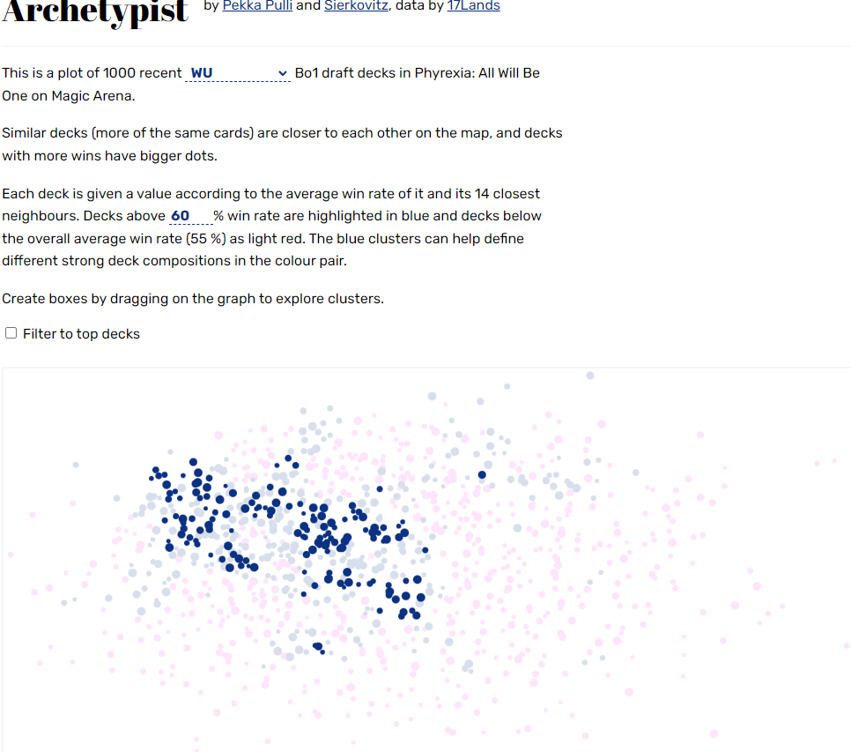

PCA (ordination) can be used to represent any high-dimensional space
Cards
Decks
https://fodorclasses.github.io/classes/stats2022/stats2022.html (lecture 18)
https://archetypist.netlify.app/

Slide 16
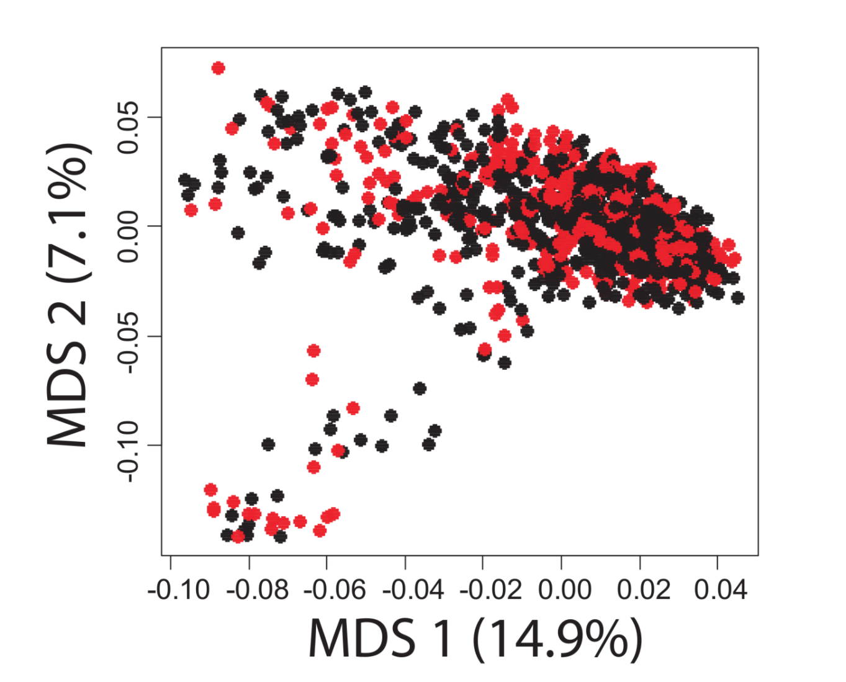
A case-control study in Colonic Diverticulosis with a small effect size
Roshonda Barner Jones
University of Southern California
Temitope Keku
UNC Chapel Hill
An Aberrant Microbiota is not Strongly Associated with Incidental Colonic Diverticulosis Roshonda B. Jones, Anthony A. Fodor, Anne F. Peery, Matthew C. B. Tsilimigras, Kathryn Winglee, Amber McCoy,Michael Sioda ,Robert S. Sandler, Temitope O. Keku. Scientific Reports. 2018.

Slide 17
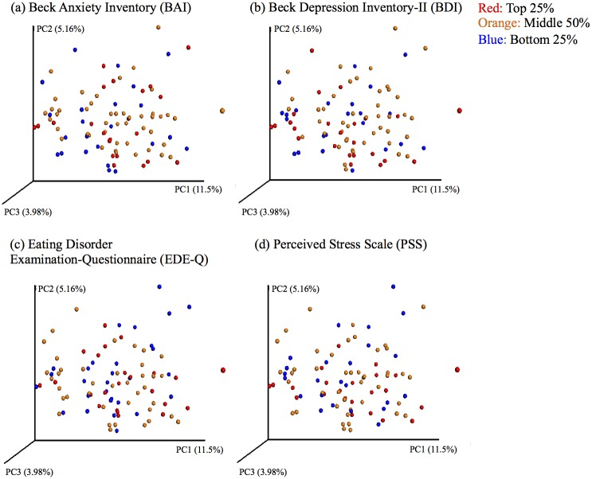

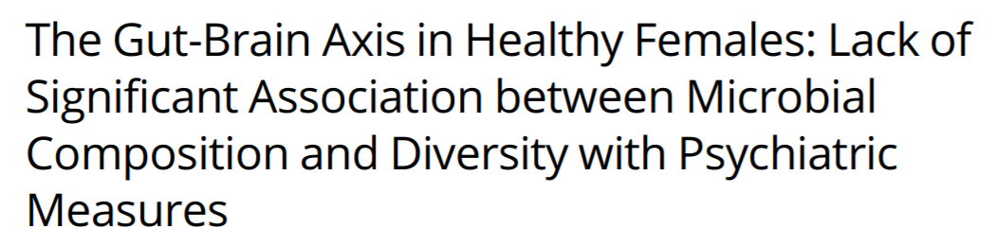
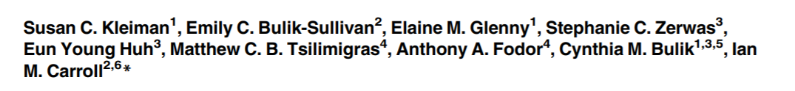
Ian Carroll
UNC Chapel Hill

Slide 18
Effect Sizes in Association Studies are Reliably Small
There is strong individual variation in the microbiome

Slide 19
Effect Sizes in Association Studies are Reliably Small
There is strong individual variation in the microbiome
Sample sizes need to be very large

Slide 20


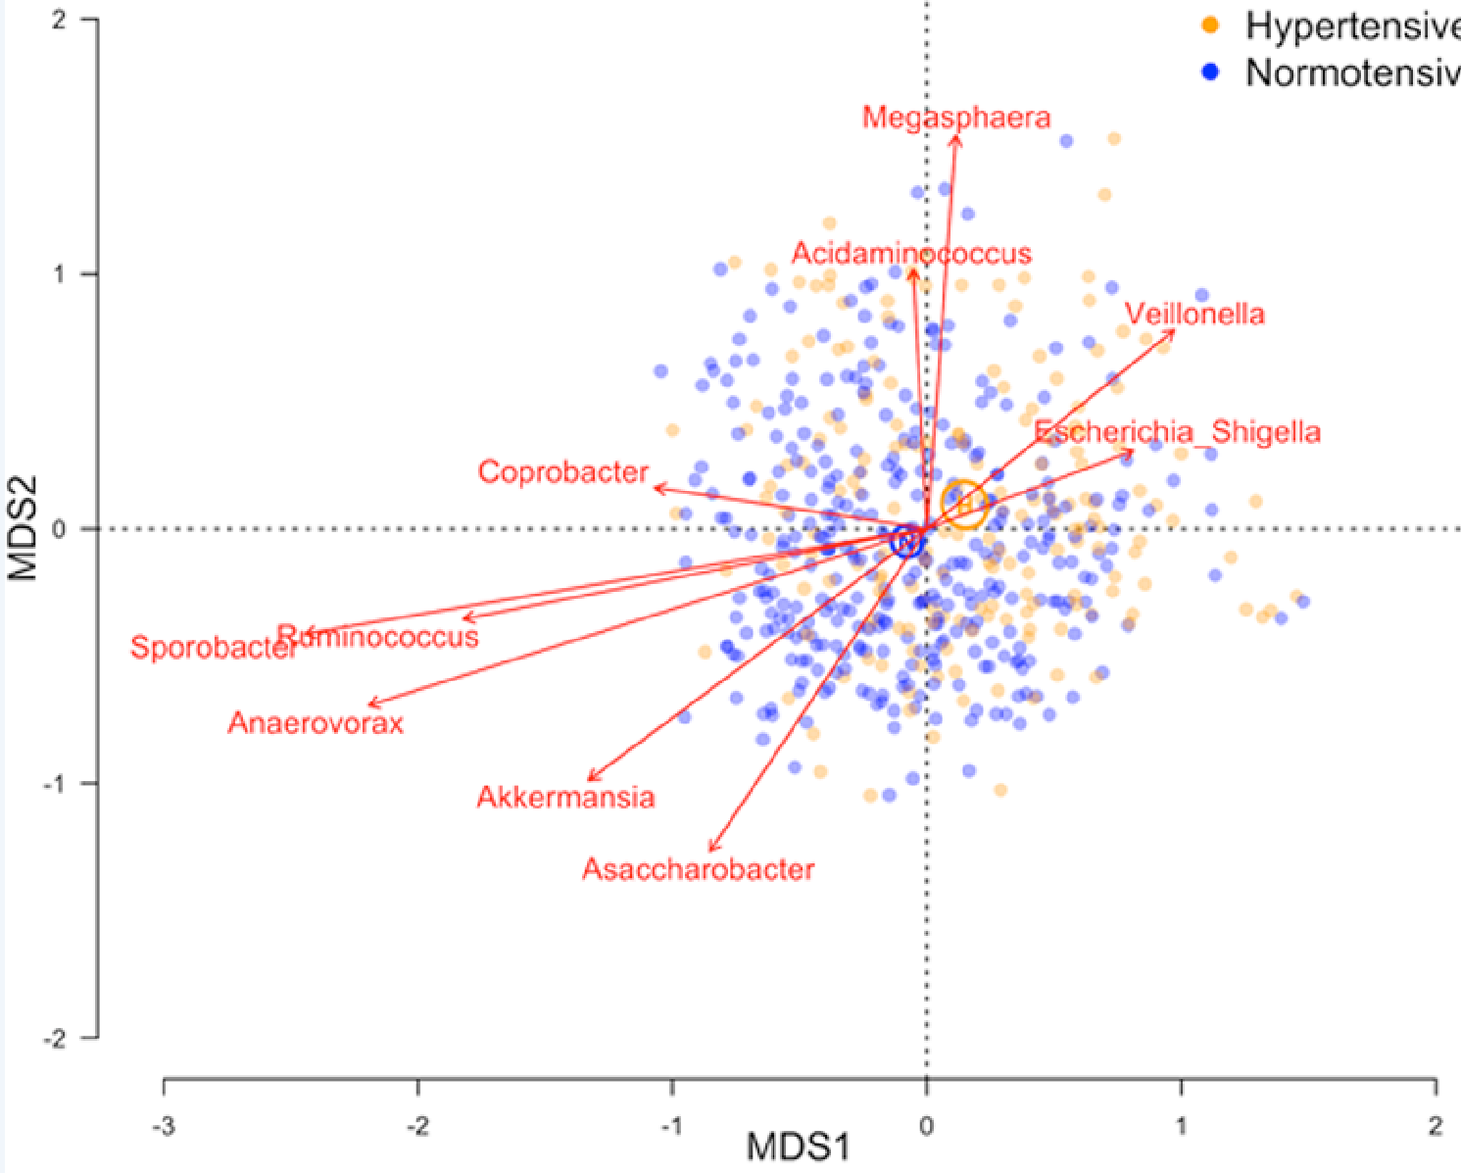
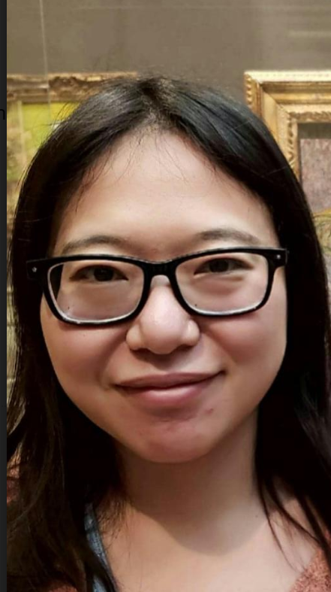
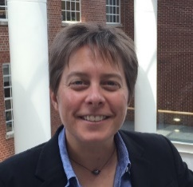
Shan Sun
UNC Charlotte
Katie Meyer UNC
N=529

Slide 21
Effect Sizes in Association Studies are Reliably Small
There is strong individual variation in the microbiome
The microbiome is an environmental variable
and important interactions with the host are
not globally conserved

Slide 22
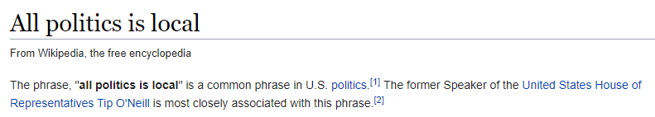
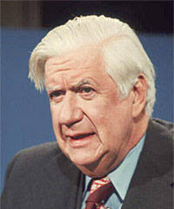

Slide 23

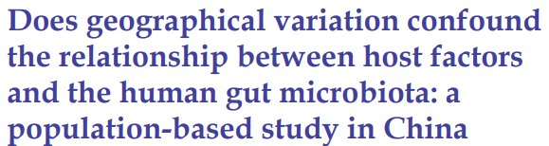
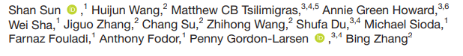
The microbiome is an environmental variable that is sensitive to local conditions
Penny Gordon-
Larsen
UNC Chapel Hill
Shan Sun
UNC Charlotte

Slide 24
The microbiome is an environmental variable that is sensitive to local conditions
2,164 subjects from the China Health and Nutrition Survey
(http://www.cpc.unc.edu/projects/china )
Penny Gordon-
Larsen
UNC Chapel Hill
Shan Sun
UNC Charlotte

Slide 25
The microbiome is an environmental variable that is sensitive to local conditions
2,164 subjects from the China Health and Nutrition Survey
(http://www.cpc.unc.edu/projects/china )
Fecal samples collected; 16S rRNA sequencing
Penny Gordon-
Larsen
UNC Chapel Hill
Shan Sun
UNC Charlotte

Slide 26
The microbiome is an environmental variable that is sensitive to local conditions
2,164 subjects from the China Health and Nutrition Survey
(http://www.cpc.unc.edu/projects/china )
Fecal samples collected; 16S rRNA sequencing
Classification and generation of count table
Penny Gordon-
Larsen
UNC Chapel Hill
Shan Sun
UNC Charlotte

Slide 27
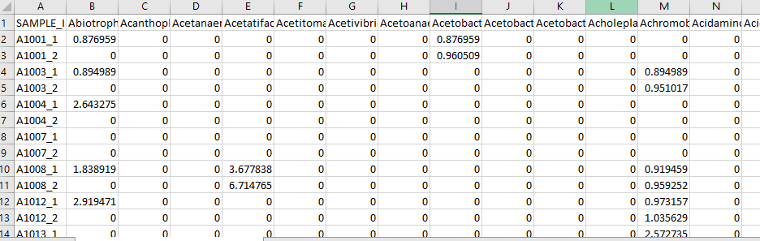
The microbiome is an environmental variable that is sensitive to local conditions
2,164 subjects from the China Health and Nutrition Survey
(http://www.cpc.unc.edu/projects/china )
Fecal samples collected; 16S rRNA sequencing
Classification and generation of count table
Penny Gordon-
Larsen
UNC Chapel Hill
Shan Sun
UNC Charlotte

Slide 28
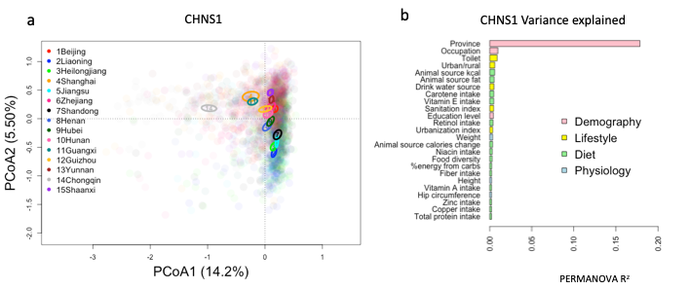
The microbiome is an environmental variable that is sensitive to local conditions
CHINA
Penny Gordon-
Larsen
UNC Chapel Hill
Shan Sun
UNC Charlotte

Slide 29
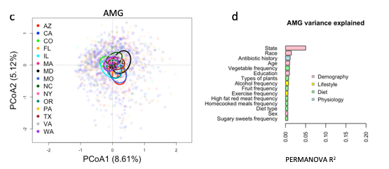
The microbiome is an environmental variable that is sensitive to local conditions
CHINA
Penny Gordon-
Larsen
UNC Chapel Hill
US
(American Gut)
Shan Sun
UNC Charlotte

Slide 30
The microbiome is an environmental variable that is sensitive to local conditions
2,164 subjects from the China Health and Nutrition Survey
(http://www.cpc.unc.edu/projects/china )
Fecal samples collected; 16S rRNA sequencing
Classification and generation of count table
Penny Gordon-
Larsen
UNC Chapel Hill
Use the microbiome to predict subject phenotype
Shan Sun
UNC Charlotte

Slide 31
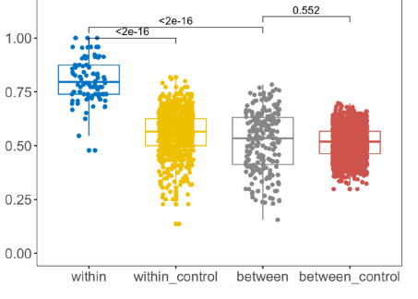
Machine learning models can be trained within but not across provinces
True Positive Rate
Penny Gordon-
Larsen
UNC Chapel Hill
Urban/Rural classification
Shan Sun
UNC Charlotte

Slide 32
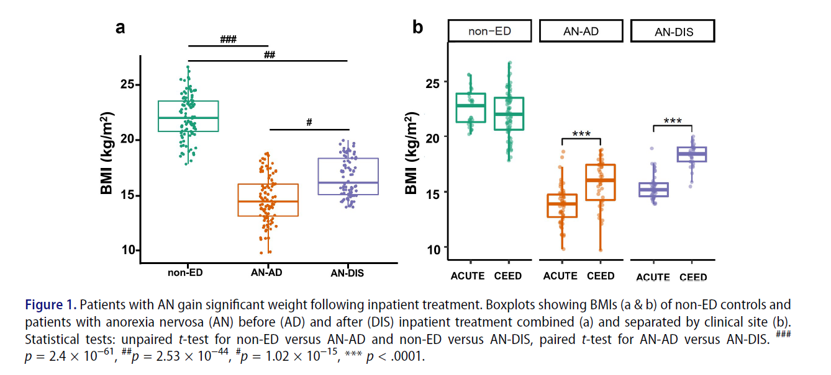
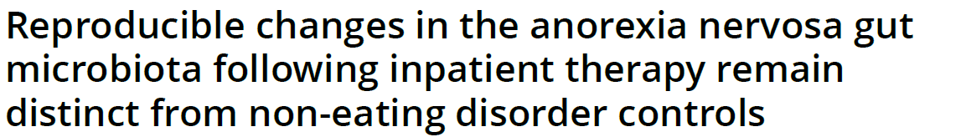
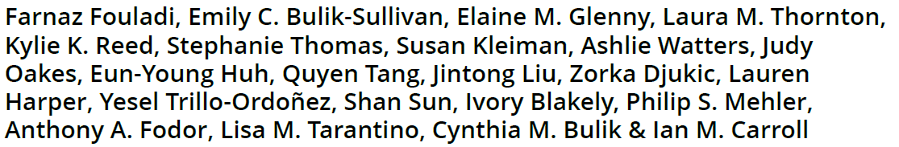
Phenotypes involving human weight pathologies show intriguing, reproducible associations with the microbiome

Slide 33
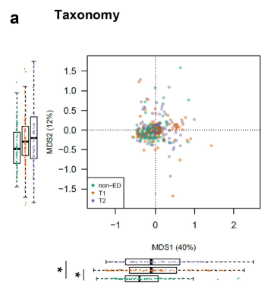
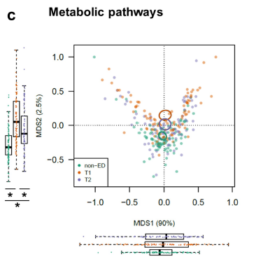
Phenotypes involving human weight pathologies show intriguing, reproducible associations with the microbiome

Slide 34
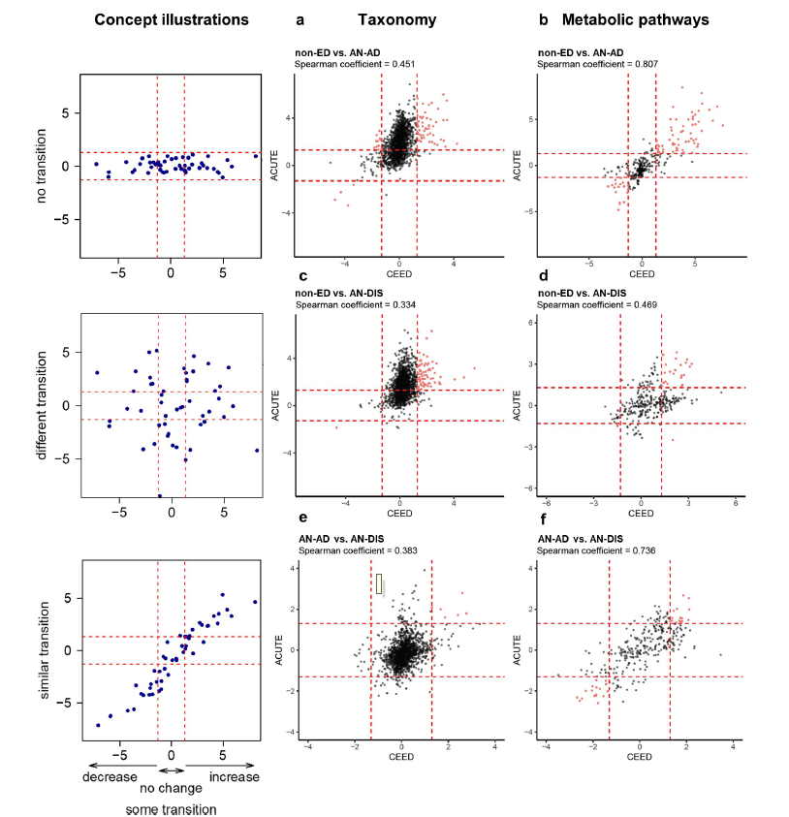

Slide 37
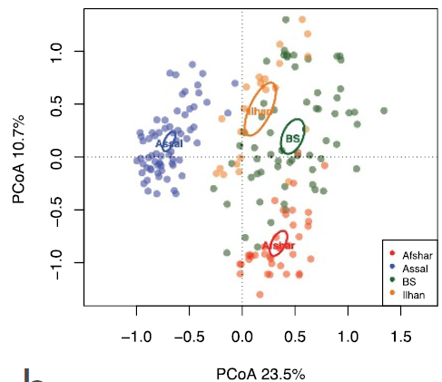
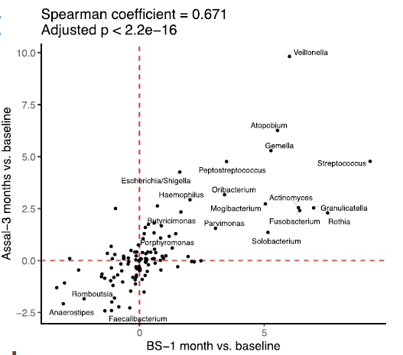
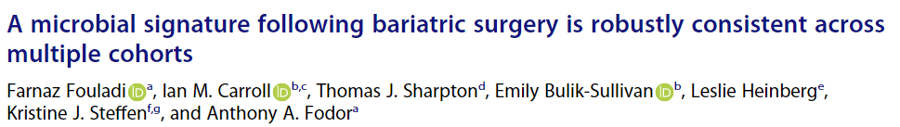
Phenotypes involving human weight pathologies show intriguing, reproducible associations with the microbiome

Slide 38
Multivariate statistical techniques are essential for analysis of
high-dimensional genomics datasets
Individual variation and local effects make the study of the microbiome
challenging
We are in early days of microbiome research but over the next decades
we will find more mechanisms by which microbes contribute to human
phenotypes

Slide 39
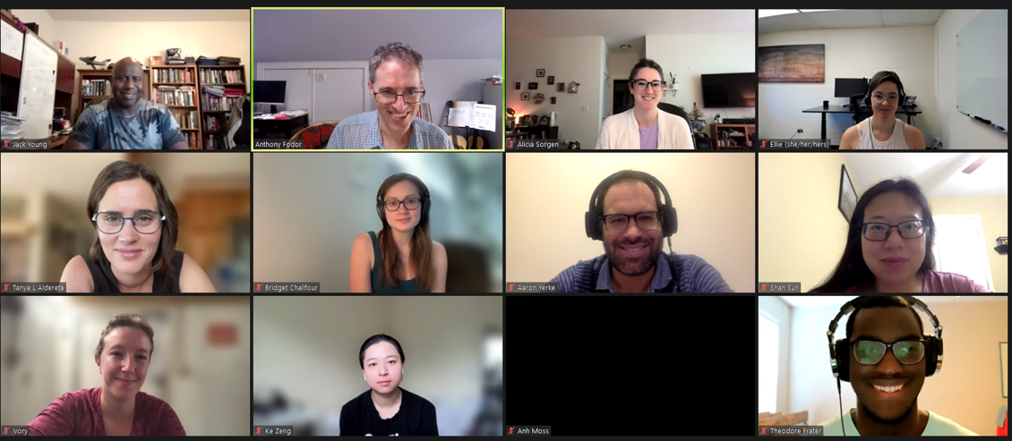
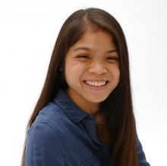





Slide 41

4K RAM (which I expanded 16K)
Cassette-tape storage
(30 bytes per second throughput)
128 * 48 Black and white graphics
BASIC (26 variables A-Z)
With 16K, this became 26^2 variables and
you could have arrays!
Z80 assembly language
I almost had to repeat 8th grade because of this computer
Learning to code was the key to a lot of what happened later
https://spectrum.ieee.org/consumer-electronics/gadgets/the-consumer-electronics-hall-of-fame-tandyradioshack-trs80-model-1

Slide 42
University of Washington Ph.D. – Ion Channel Biophysics
Random startups as a Java Developer in Seattle ( 2 years)
Bioinformatics analyst at Immunex/Amgen ( 2 years )
Post-doctoral associate/research fellow at Stanford (3 years)
Tenure track research position at UNC Charlotte ( 15 years)

